Slide 1
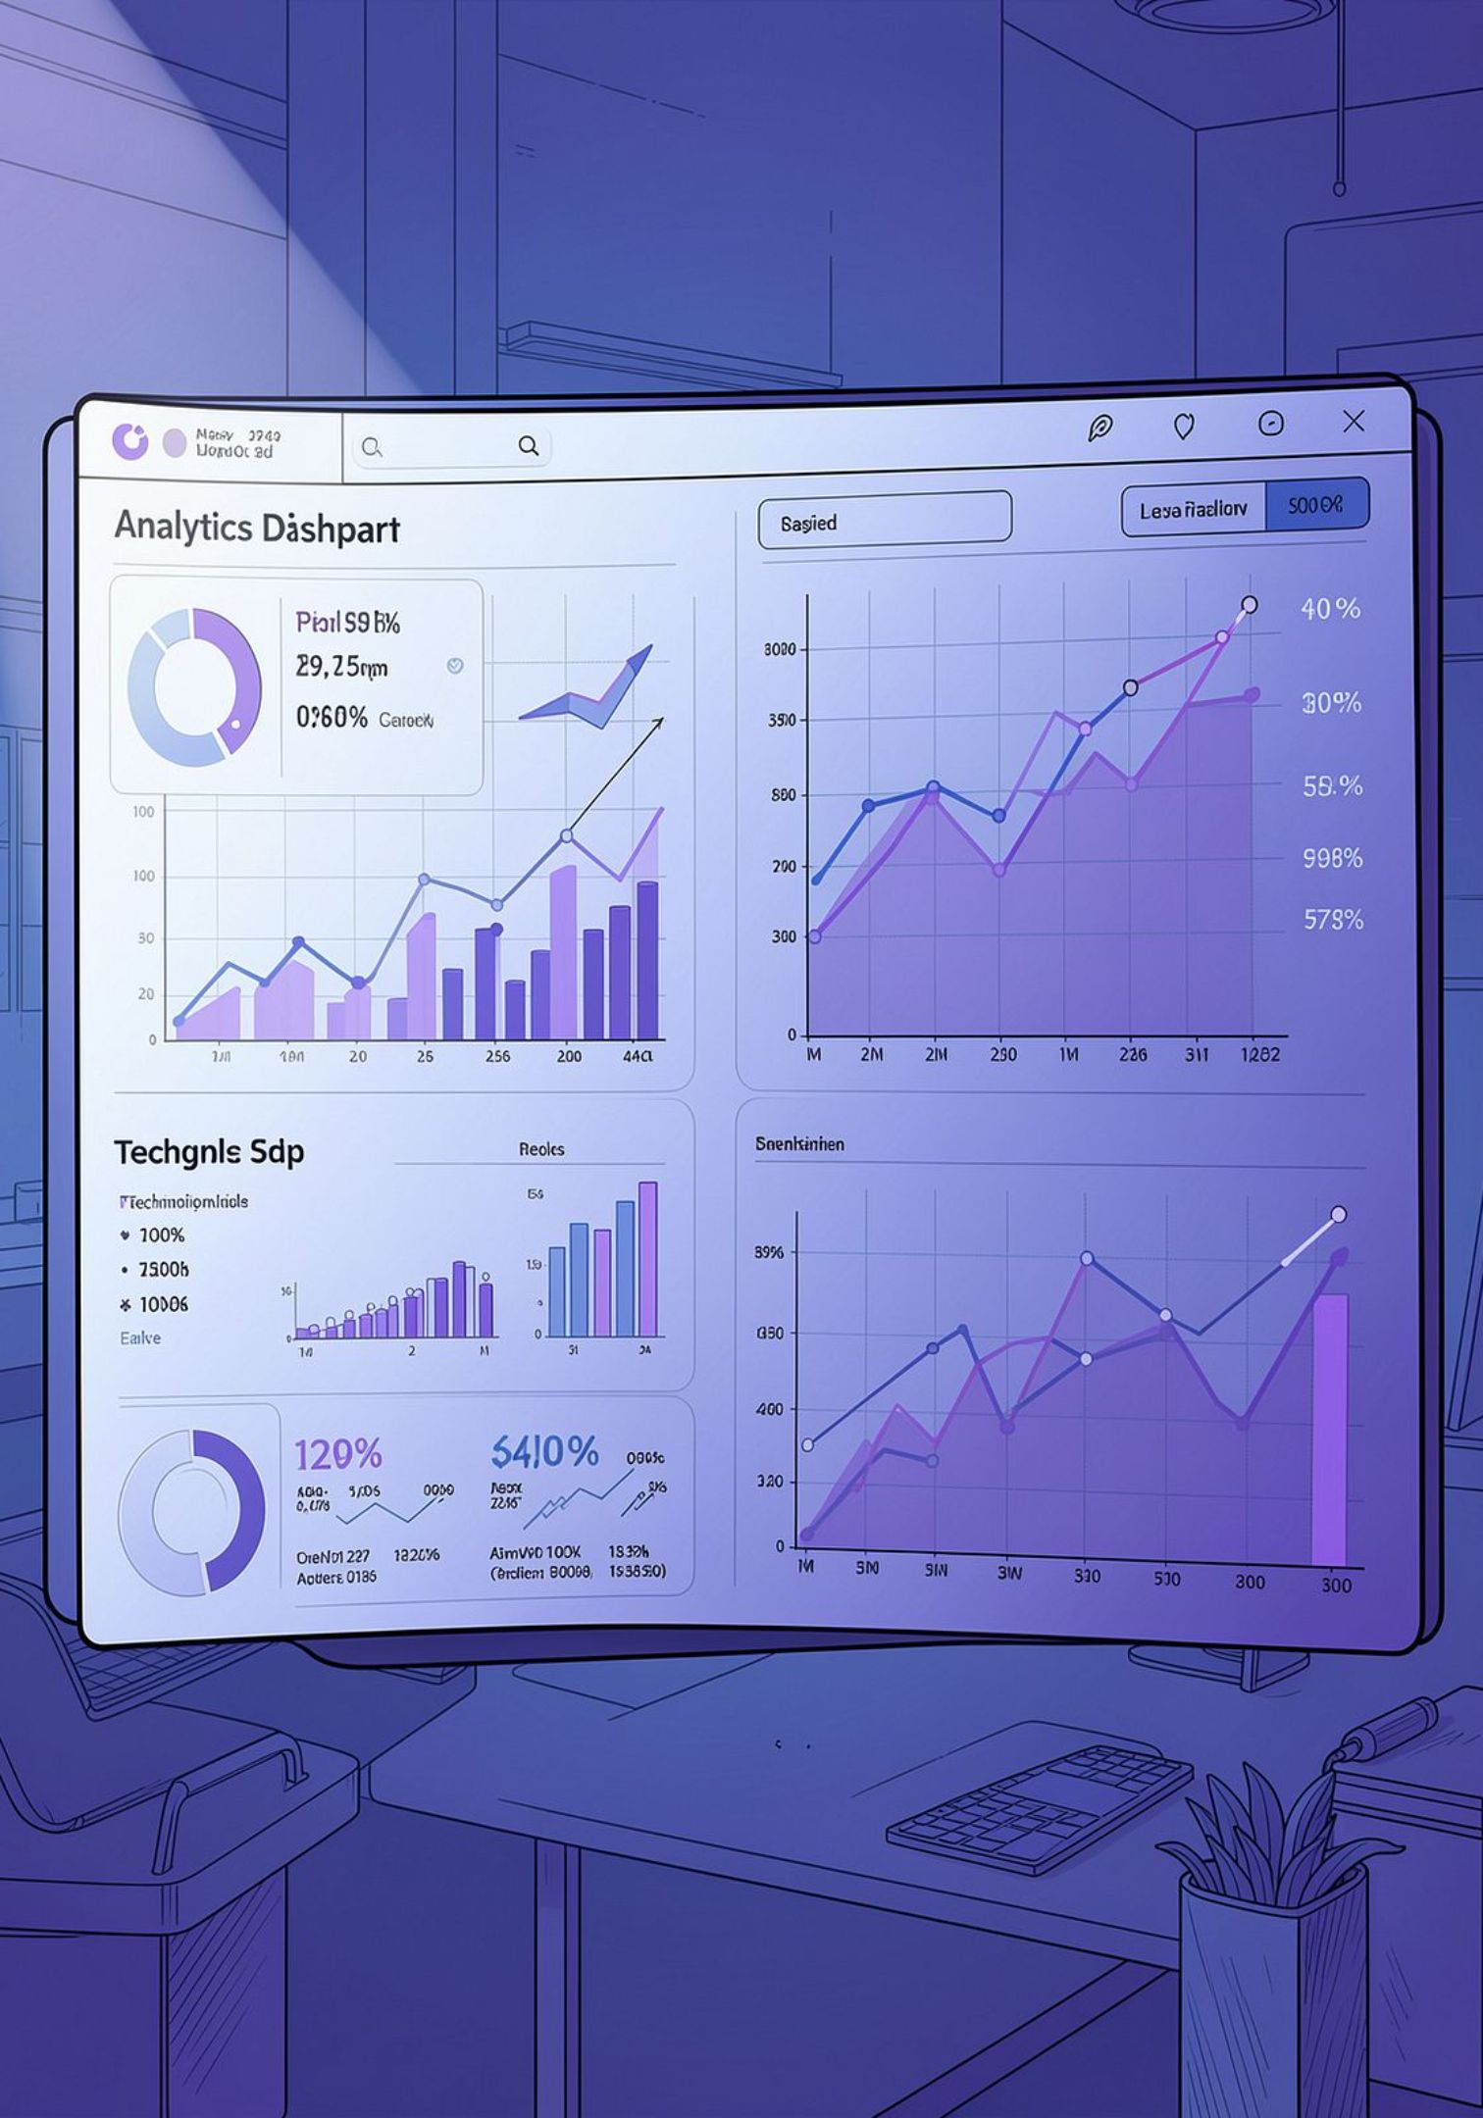
Supportlytics
Optimizing IT Support Team Performance Using Analytics
Milestone 3 – Week 5–6
Presented by Srikanth K

Slide 2

Milestone 3 Overview
Module 5 – Performance Trend Analysis
Module 6 – Geographic & Category-Level Insights
Analyze average resolution time by priority
Analyze average resolution time by ticket type
Identify countries with the fastest ticket resolution
Compare support queue performance
Identify unresolved high-priority tickets
Create heatmaps of ticket concentration by region
Map issue categories geographically using lat/long
Analyze cluster size versus performance score
Summarize geographic and performance metrics
Process: Data Cleaning ↓ Country Feature Engineering ↓ Performance Analysis ↓ Geographical Analysis ↓ Business Insights ↓ Recommendations

Slide 3
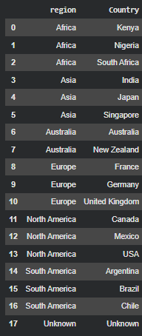

Feature Engineering — Country Mapping
Original dataset lacked a Country field. We engineered a Country column by mapping each Region to representative countries to enable geographic analysis and visualizations.
Example mappings
North America: USA, Canada, Mexico
Europe: Germany, France, United Kingdom
Asia: India, Japan, Singapore
Africa: South Africa, Nigeria, Kenya
Australia: Australia, New Zealand
Unknown: Unknown
Created a Country feature to power Module 6 visualizations and country-level comparisons.
Business impact: region-wise and country-wise performance comparison, improved visualization fidelity.

Slide 4
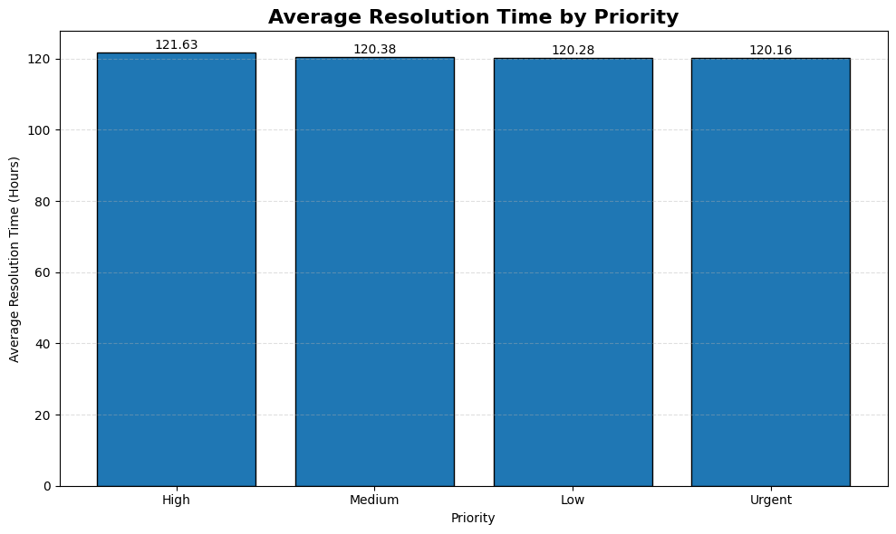
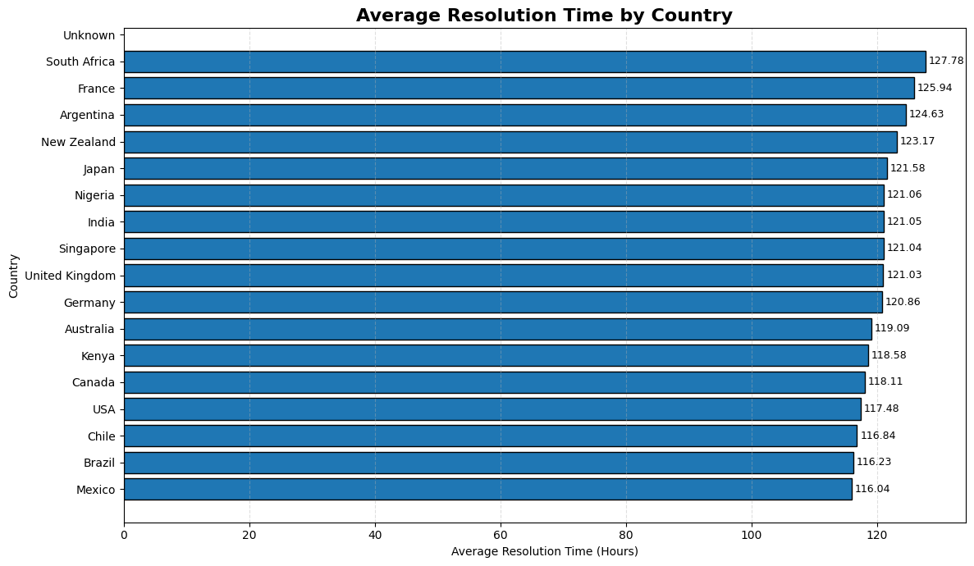
Module 5 — Average Resolution Time Analysis
📊 Average Resolution Time by Priority
Insights:
Resolution time is nearly consistent across all priority levels (≈120 hours).
High-priority tickets show slightly higher average resolution time, indicating additional handling effort.
🌍 Average Resolution Time by Country
Insights:
Resolution time varies across countries, reflecting differences in regional support performance.
Countries with lower average resolution times demonstrate more efficient ticket resolution and can serve as operational benchmarks.
Insert: Average Resolution Time by Ticket Type
Insert: Average Resolution Time by Country
Key findings below summarise actionable patterns from the visualizations.
Critical tickets require more resolution time — SLA risk.
Request-type tickets are the largest operational workload.
Some countries show significantly faster resolution performance.
Regional comparison highlights operational efficiency differences.

Slide 5
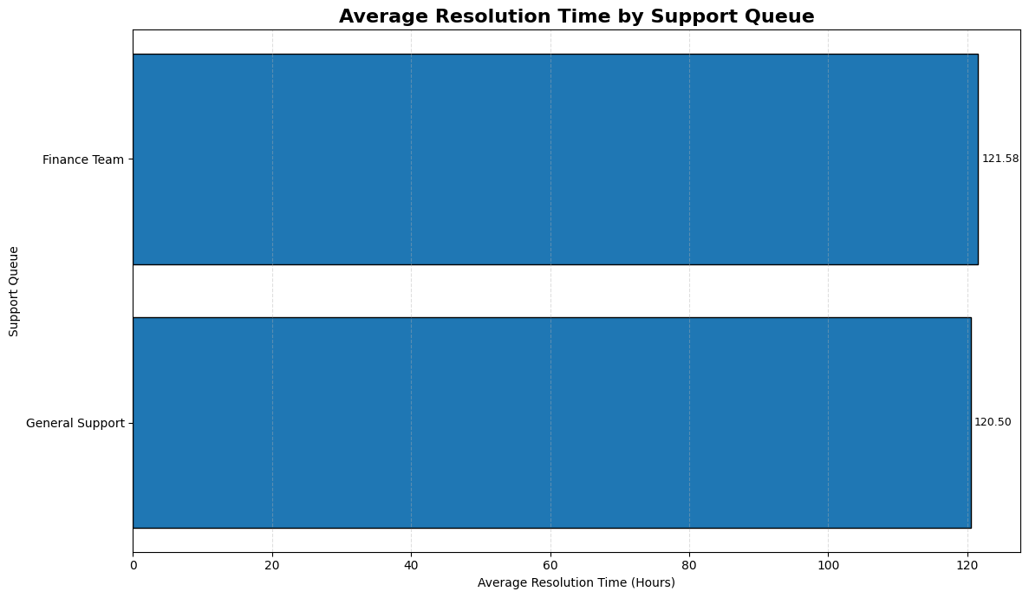
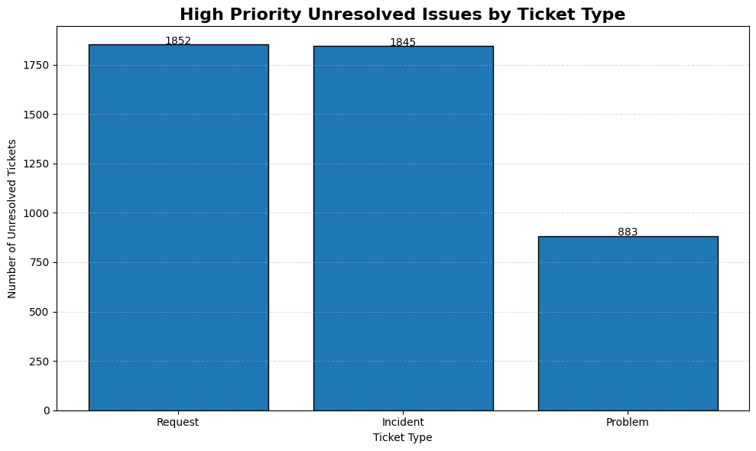
Support Queue Performance Comparison
📊 Average Resolution Time by Support Queue
Key Insights
General Support and Finance Team show nearly similar average resolution times.
Queue performance is consistent, indicating balanced workload distribution.
Monitoring queue performance helps optimize resource allocation.
📊 High Priority Unresolved Issues by Ticket Type
Key Insights
Request and Incident tickets have the highest number of unresolved high-priority issues.
Problem tickets show comparatively fewer unresolved cases.
High unresolved ticket volumes highlight areas requiring immediate operational attention.

Slide 6
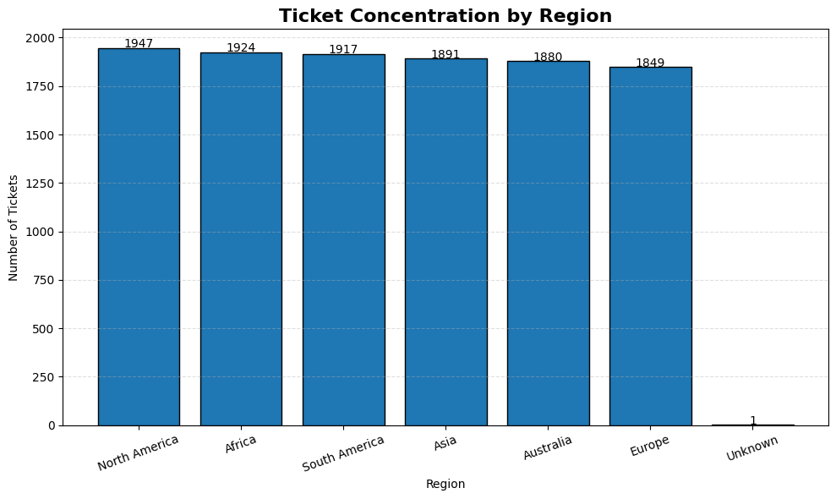
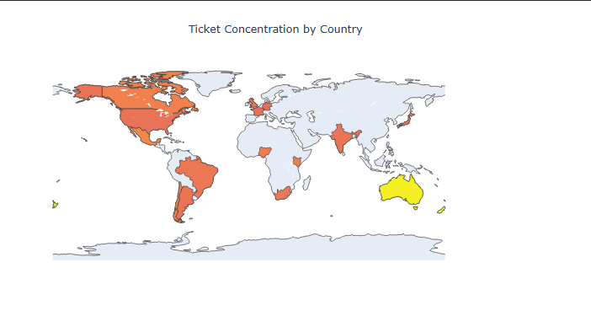
Ticket Concentration by Region And Country
📊 Ticket Concentration by Region
Key Insights
Ticket volume is distributed across all regions with only minor variations.
North America records the highest ticket concentration, indicating greater support demand.
Regional ticket analysis helps optimize workload distribution and resource planning.
🌍 Ticket Concentration by Country
Key Insights
Ticket distribution varies across countries, highlighting geographic differences in support demand.
Countries with higher ticket volumes may require additional support resources.
Geographic visualization enables better regional monitoring and strategic planning.

Slide 7
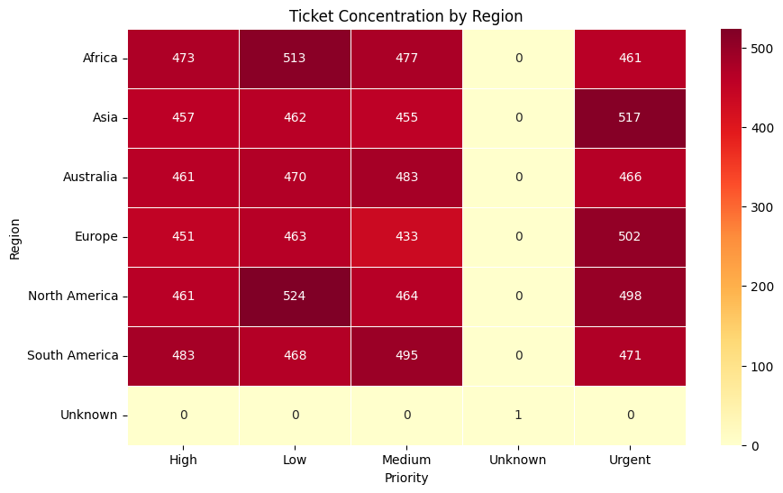
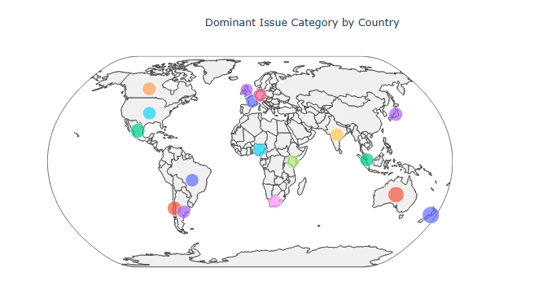
Geographic Issue Category Mapping
🌍 Dominant Issue Category by Country
Key Insights
Dominant issue categories vary across different countries.
Geographic mapping highlights regional patterns in customer support requests.
Country-level insights support targeted resource allocation and issue management.
🔥 Ticket Concentration Heatmap by Region
Key Insights
High and urgent priority tickets are consistently observed across most regions.
North America and Asia show relatively higher ticket concentrations for urgent issues.
The heatmap helps identify regional hotspots for workload planning.

Slide 8
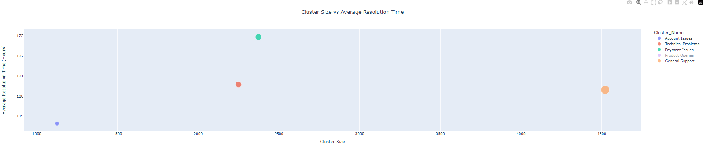
Cluster Performance Analysis
📈 Cluster Performance Analysis
Key Insights
Larger ticket clusters generally require more resolution effort and processing time.
Technical and General Support clusters handle the highest ticket volumes, indicating major operational workloads.
Cluster-level analysis helps optimize ticket routing, resource allocation, and support team performance.

Slide 9
Milestone 3 — Summary
Module 6 – Geographic & Cluster Analysis
Engineered a new Country feature from the existing Region column.
Created ticket concentration visualizations by region and country.
Developed geographic heatmaps and issue category mapping using latitude and longitude.
Evaluated the relationship between cluster size and average resolution time through cluster performance analysis.
Module 5 – Performance Trend Analysis
Analyzed average resolution time by priority, ticket type, country, and support queue.
Identified high-priority unresolved tickets requiring operational attention.
Compared support team performance using multiple analytical visualizations.
.
Key Outcomes
Successfully completed all Module 5 performance trend analyses.
Successfully completed all Module 6 geographic and cluster-based analyses.
Generated meaningful visualizations and business insights to support data-driven decision-making.
Improved understanding of support operations through comparative and geographic analytics.

Slide 10
THANK YOU

